Slide 1
VOICE BASED FORM FILLING PROJECT
FOR EDUCATION SECTOR
Presented by
Vakala Yamini

Slide 2
Problem Statement
Problem: Difficulty for disabled individuals to fill out forms and time consumption for others.
Solution: A voice-driven form-filling system.
Focus: Education sector (Student registration form).

Slide 3
Key Features
Frontend Pages:
Home, Signup, Login, Student Registration.
Voice Input:
Uses OpenAI's Whisper for transcription.
Google Translator for speech-to-text conversion.

Slide 4
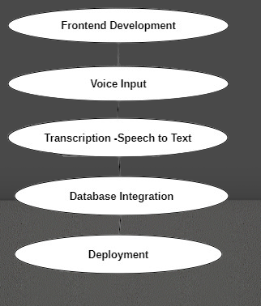
Modules

Slide 5
Workflow
Signup:
Email validation and redirection based on the result.
Login:
Credential verification.
Form Filling:
Voice input for fields like name, email, etc.
Validation and submission of the form.

Slide 6
Tools and Technologies
Frontend Development:
HTML, CSS, JavaScript
Flask
Voice Input and Transcription:
OpenAI Whisper
Google Translator API
Database:
MySQL
Deployment:
Render

Slide 7
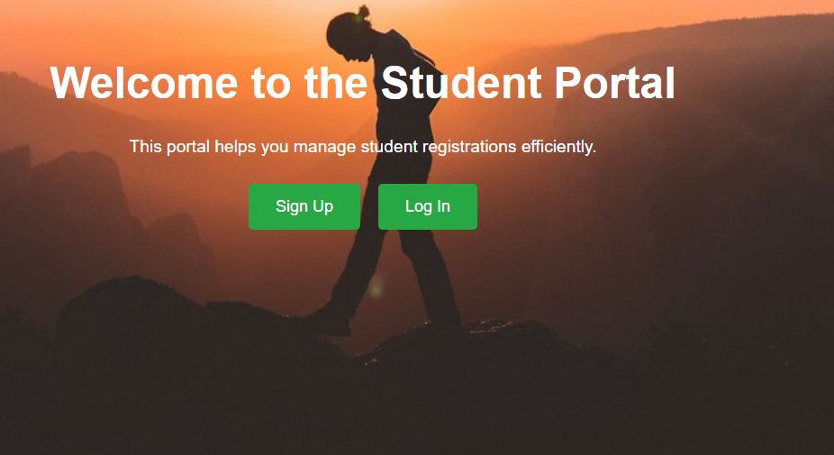
Home Page

Slide 8
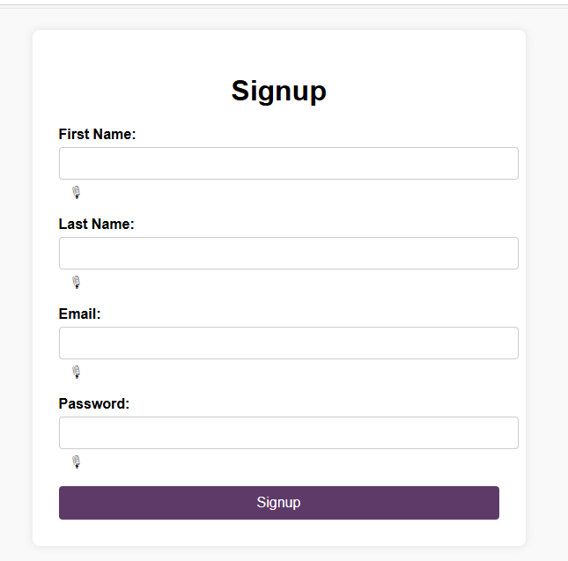
Signup Page

Slide 9
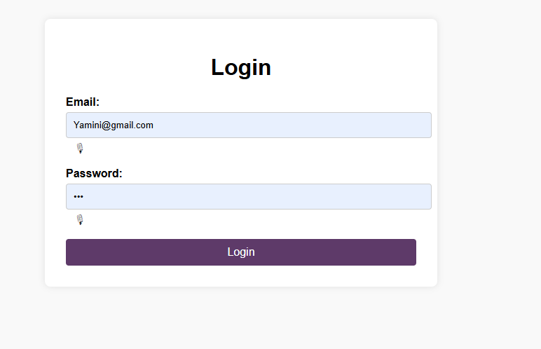
Login Page

Slide 10
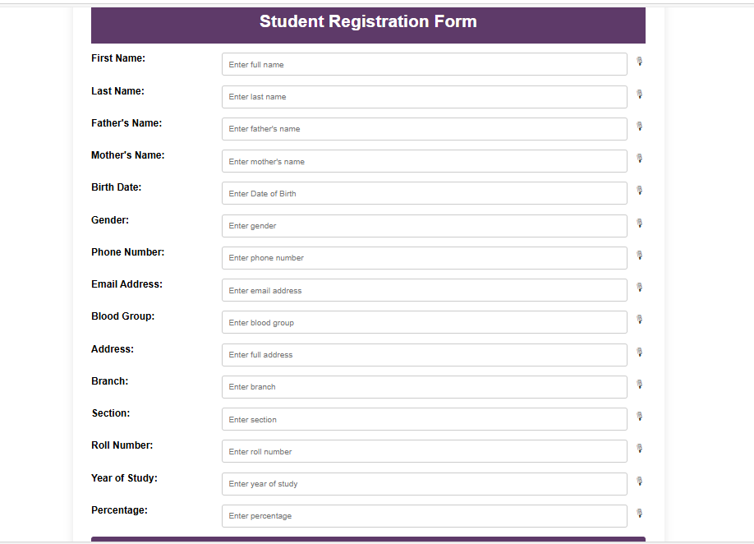
Registration Page

Slide 11
Conclusion
Impact:
Saves time.
Provides accessibility for individuals with disabilities.
Simplifies the form-filling process.
Deployment:
Live and accessible via Render.

Slide 12
Thank You

